Slide 1
MET CS 555 – Foundations of Machine Learning Lecture 6: Assessing the Fit
Hongsheng Wu
Boston University

Slide 2
Study Guide
Interpretation of Results
Assessing the Fit of Linear Regression
Inference of Regression Coefficients

Slide 3
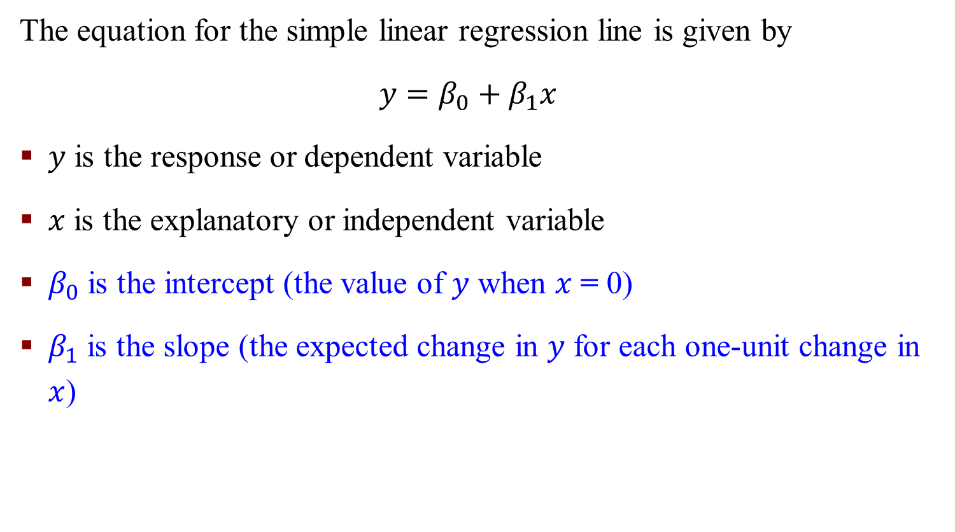
Simple Linear Regression (SLR)
The equation for the simple linear regression line is given by
$$y=β_{0}+β_{1}x$$
$y$ is the response or dependent variable
$x$ is the explanatory or independent variable
$β_{0}$ is the intercept (the value of $y$ when $x$ = 0)
$β_{1}$ is the slope (the expected change in $y$ for each one-unit change in $x$)

Slide 4
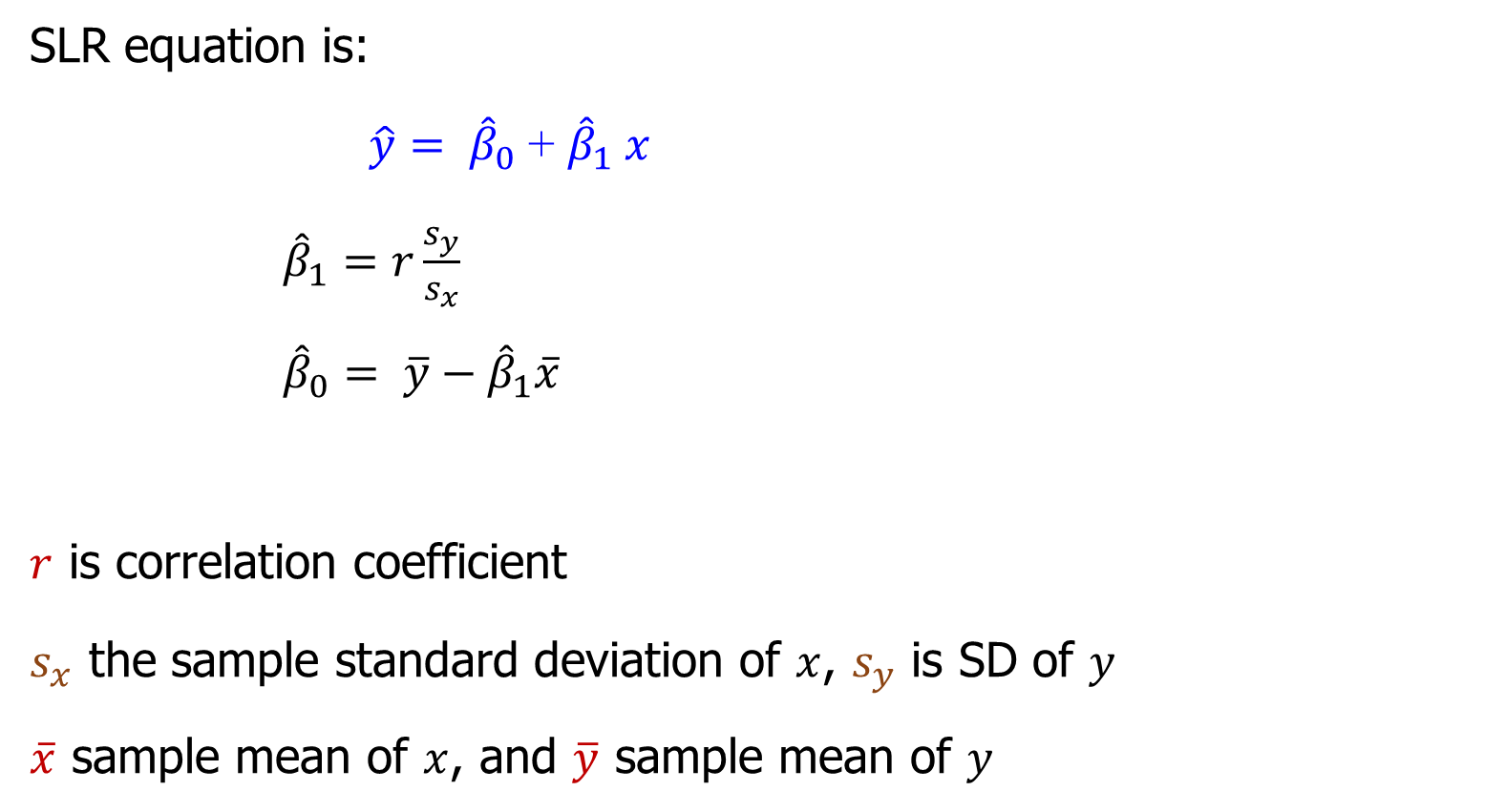
Equation for the least-squares regression line
SLR equation is:
$\hat{y}= {\hat{β}}_{0}$ + ${\hat{β}}_{1} x$
${\hat{β}}_{1}=r\frac{s_{y}}{s_{x}}$
${\hat{β}}_{0}= \overline{y}−{\hat{β}}_{1}\overline{x}$
$r$ is correlation coefficient
$s_{x}$ the sample standard deviation of $x$, $s_{y}$ is SD of $y$
$\overline{x}$ sample mean of $x$, and $\overline{y}$ sample mean of $y$

Slide 5
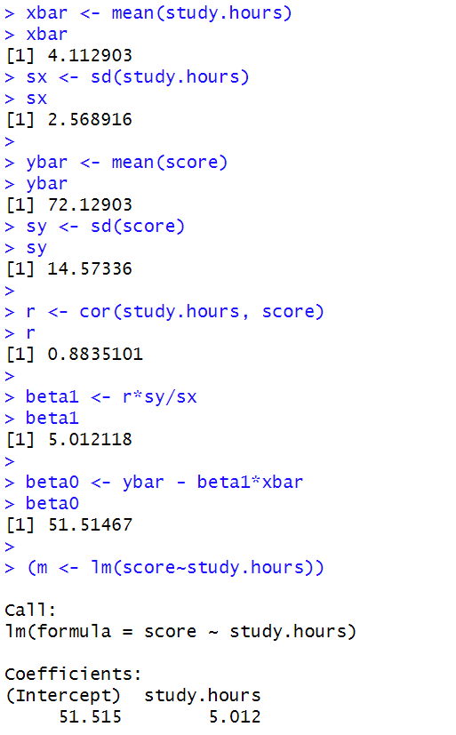
An Example - Study Hours vs. Exam Scores
$$\hat{y}=51.51+5.012x$$

Slide 6
Interpretation of Results

Slide 7

Interpretation of Results
The estimate of the slope parameter (${\hat{β}}_{1}$) gives the expected or predicted change in the response variable $\hat{y}$for a one-unit increase in the explanatory variable (x). Here, ${\hat{β}}_{1}$= 5.012.
Can be interpreted as the increase
in exam score for every one-hour
increase in study time.
For each additional hour that students
studied, their exam score improved
by around 5% points on average.
$$\hat{y}=51.51+5.012x$$

Slide 8

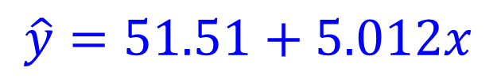
Interpretation of Results
The Linear Nature of the relationship and the equation implies that the increase in exam score is the same for any 1-unit change. An increase from 2 to 3 hours is the same as an increase from 8 hours to 9 hours
The estimate for the intercept ($β_{0}$) is meaningful in this case since values of the explanatory variable near 0 are possible. Here, $β_{0}$ = 51.515. This can be interpreted as the average exam grade for those who did not study
$$\hat{y}=51.51+5.012x$$

Slide 9
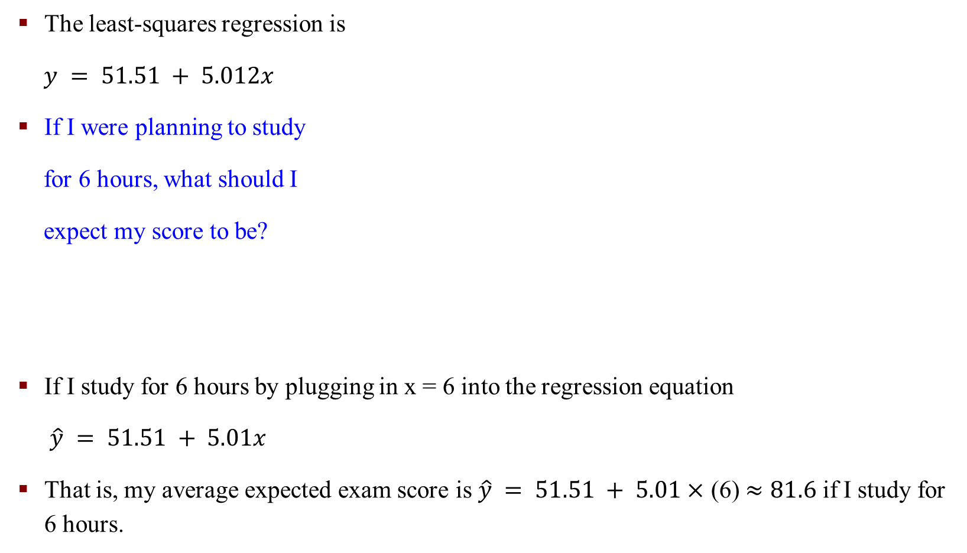
Interpretation of Results - Example
The least-squares regression is
$y = 51.51 + 5.012x$
If I were planning to study
for 6 hours, what should I
expect my score to be?
If I study for 6 hours by plugging in x = 6 into the regression equation
$\hat{y} = 51.51 + 5.01x$
That is, my average expected exam score is $\hat{y} = 51.51 + 5.01×$ (6) $≈81.6$ if I study for 6 hours.

Slide 10

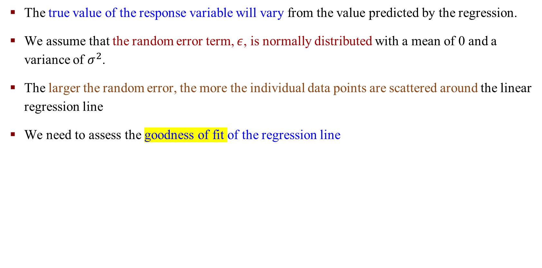
Random Error $ε$
The true value of the response variable will vary from the value predicted by the regression.
We assume that the random error term, $ε$, is normally distributed with a mean of 0 and a variance of $σ^{2}$.
The larger the random error, the more the individual data points are scattered around the linear regression line
We need to assess the goodness of fit of the regression line
Notes:
$ε$ Epsilon

Slide 11
Assessing the Fit of Linear Regression

Slide 12

The Coefficient of determination or R-squared
The coefficient of determination, or${ R}^{2}$, is a number that indicates how well data fit a statistical model in our case, the regression line
${ R}^{2}$ represents the proportion (percentage) of the variation in the response variable explained by the regression model (equation)

Slide 13
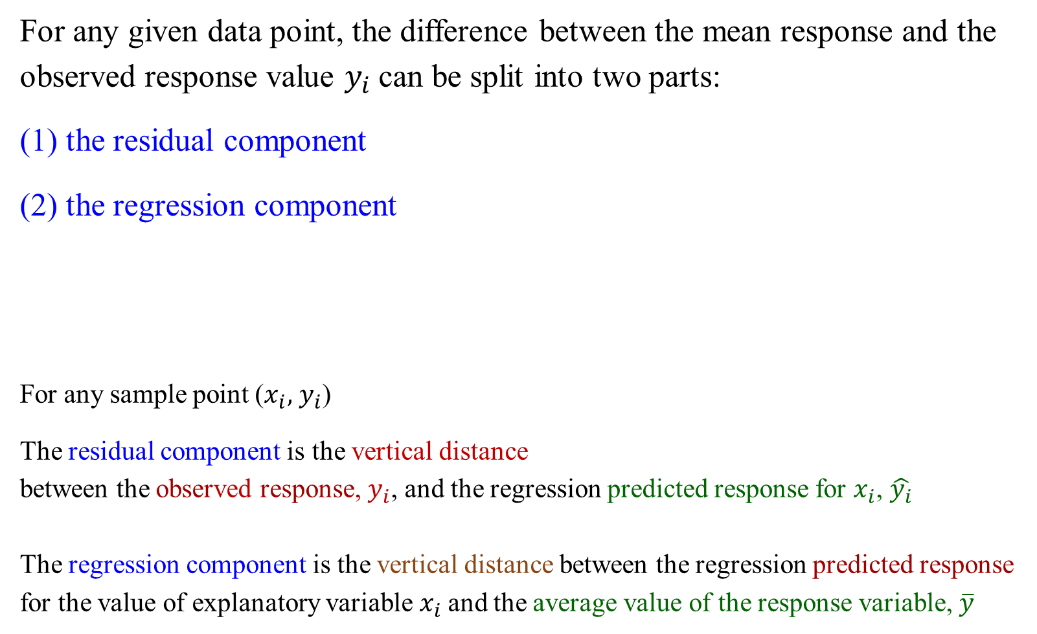
Assessing the Fit of the Regression Line
For any given data point, the difference between the mean response and the observed response value $y_{i}$can be split into two parts:
(1) the residual component
(2) the regression component
For any sample point ($x_{i},$ $y_{i}$)
The residual component is the vertical distance
between the observed response, $y_{i}$, and the regression predicted response for $x_{i}$, $\hat{y_{i}}$
The regression component is the vertical distance between the regression predicted response for the value of explanatory variable $x_{i}$and the average value of the response variable, $\overline{y}$
actual data
estimate data

Slide 14
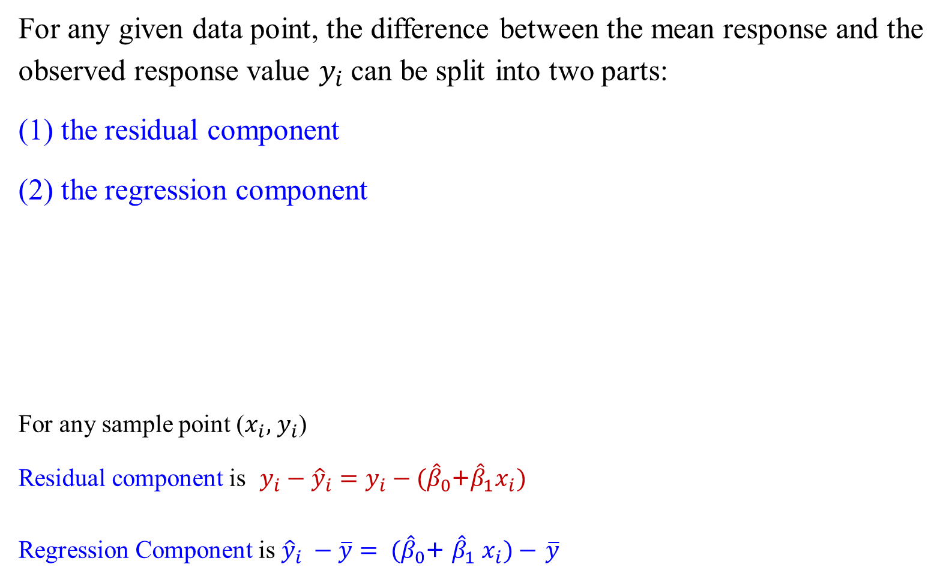
Assessing the Fit of the Regression Line
For any given data point, the difference between the mean response and the observed response value $y_{i}$can be split into two parts:
(1) the residual component
(2) the regression component
For any sample point ($x_{i},$ $y_{i}$)
Residual component is $y_{i}−{\hat{y}}_{i}=y_{i}−({\hat{β}}_{0}$+${\hat{β}}_{1}x_{i})$
Regression Component is ${\hat{y}}_{i} −\overline{y}= ({\hat{β}}_{0}$+ ${\hat{β}}_{1} x_{i})−$ $\overline{y}$
actual data
estimate data

Slide 15
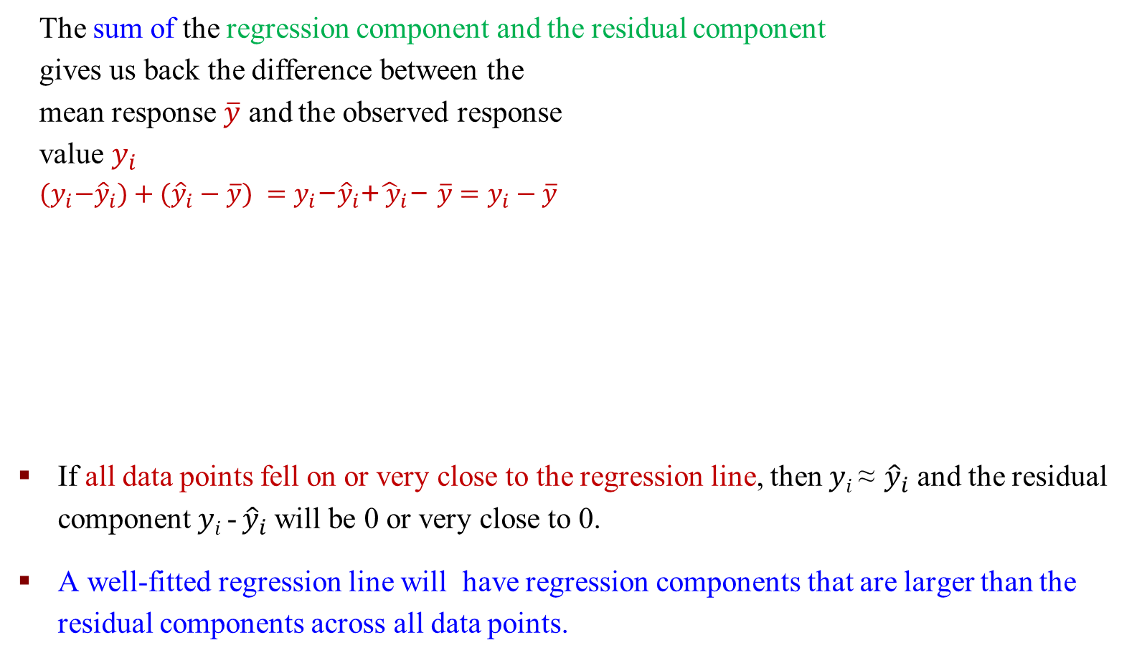
Assessing the Fit of the Regression Line
The sum of the regression component and the residual component
gives us back the difference between the
mean response $\overline{y}$ and the observed response
value $y_{i}$
$${(y}_{i}−{\hat{y}}_{i})+({\hat{y}}_{i}−\overline{y}) ={y_{i}\text{−}{\hat{y}}_{i}\text{+}{\hat{ y}}_{i}\text{− }\overline{y}=y}_{i}−\overline{y}$$
If all data points fell on or very close to the regression line, then $yi$ ≈ ${\hat{y}}_{i}$ and the residual component $yi$ - ${\hat{y}}_{i}$will be 0 or very close to 0.
A well-fitted regression line will have regression components that are larger than the residual components across all data points.

Slide 16
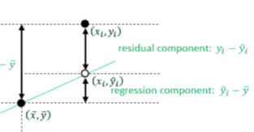
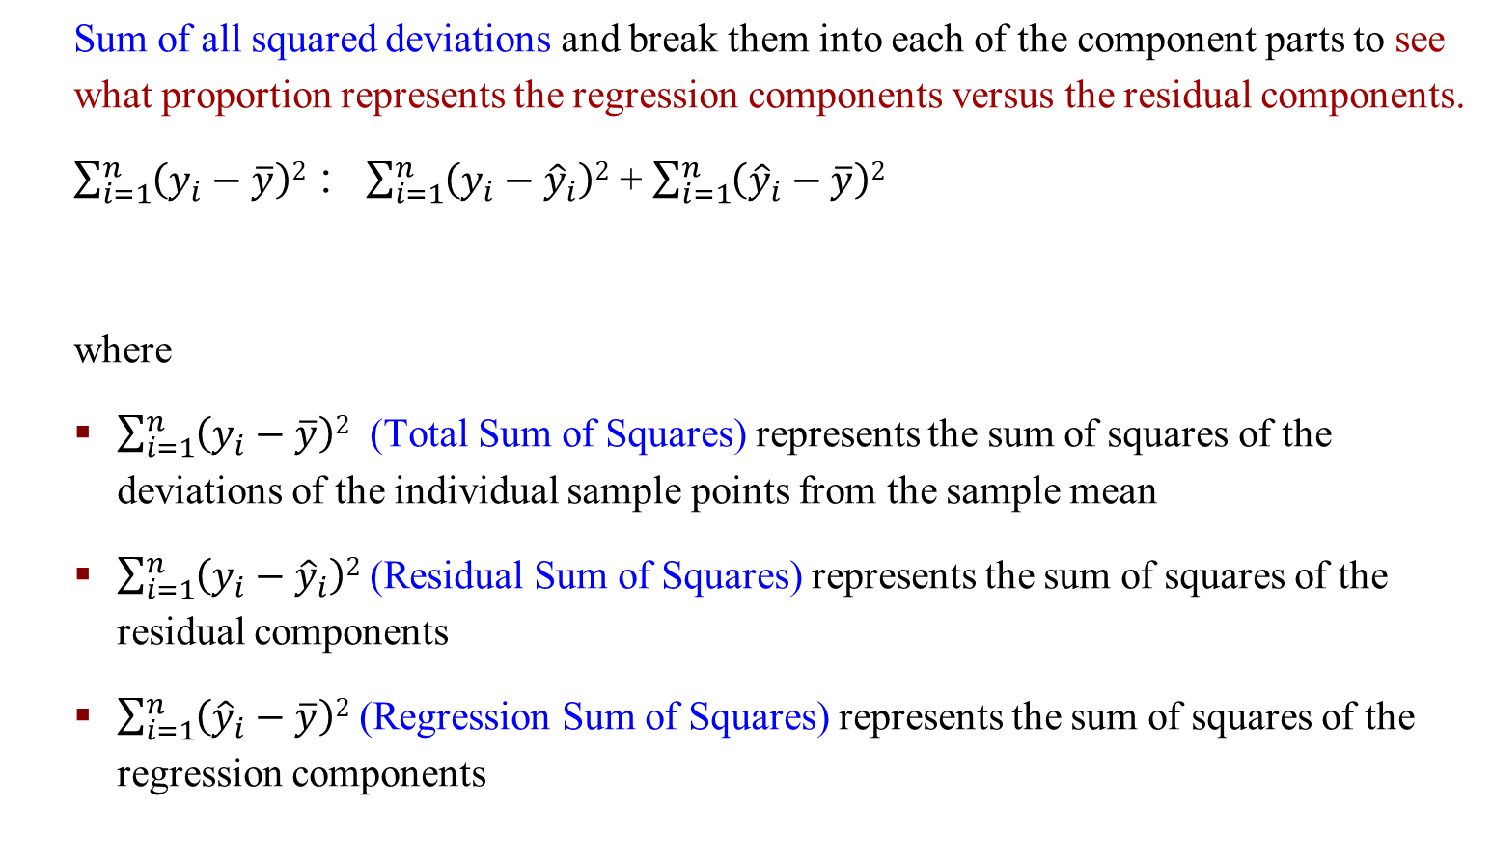
The Coefficient of Determination or R-squared
Sum of all squared deviations and break them into each of the component parts to see what proportion represents the regression components versus the residual components.
$\sum_{i=1}^{n}{\left(y_{i}−\overline{y}\right)2}$ ： $\sum_{i=1}^{n}{\left(y_{i}−{\hat{y}}_{i}\right)2}$ + $\sum_{i=1}^{n}{\left({\hat{y}}_{i}−\overline{y}\right)2}$
where
$\sum_{i=1}^{n}{\left(y_{i}−\overline{y}\right)2}$ (Total Sum of Squares) represents the sum of squares of the deviations of the individual sample points from the sample mean
$\sum_{i=1}^{n}{\left(y_{i}−{\hat{y}}_{i}\right)2}$ (Residual Sum of Squares) represents the sum of squares of the residual components
$\sum_{i=1}^{n}{\left({\hat{y}}_{i}−\overline{y}\right)2}$ (Regression Sum of Squares) represents the sum of squares of the regression components

Slide 17
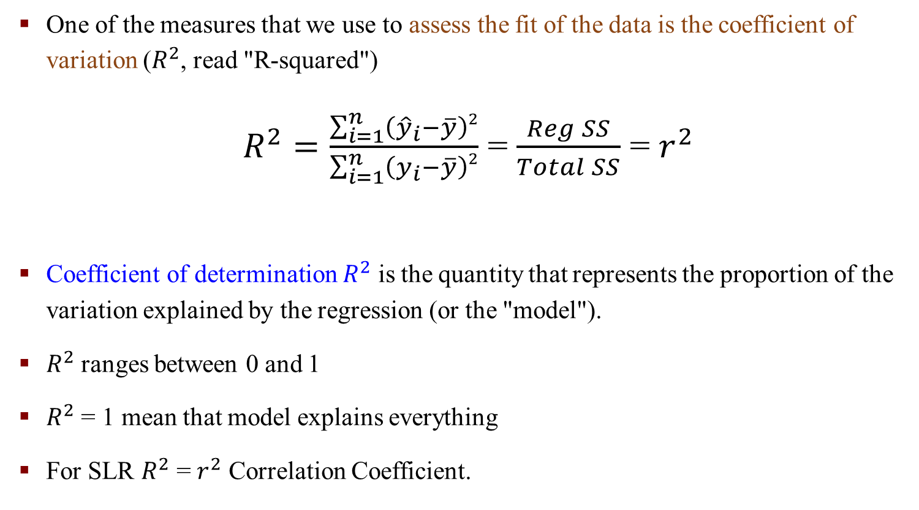
The Coefficient of Determination or R-squared
One of the measures that we use to assess the fit of the data is the coefficient of variation ($R^{2}$, read "R-squared")
$R^{2}=\frac{\sum_{i=1}^{n}{\left({\hat{y}}_{i}−\overline{y}\right)2}}{\sum_{i=1}^{n}{\left(y_{i}−\overline{y}\right)2}}$ = $\frac{Reg SS}{Total SS}$ = $r^{2}$
Coefficient of determination $R^{2}$ is the quantity that represents the proportion of the variation explained by the regression (or the "model").
$R^{2}$ ranges between 0 and 1
$R^{2}$ = 1 mean that model explains everything
For SLR $R^{2}$ = $r^{2}$ Correlation Coefficient.
Notes:
SS: sum of square

Slide 18
Inference about Regression Coefficients

Slide 19
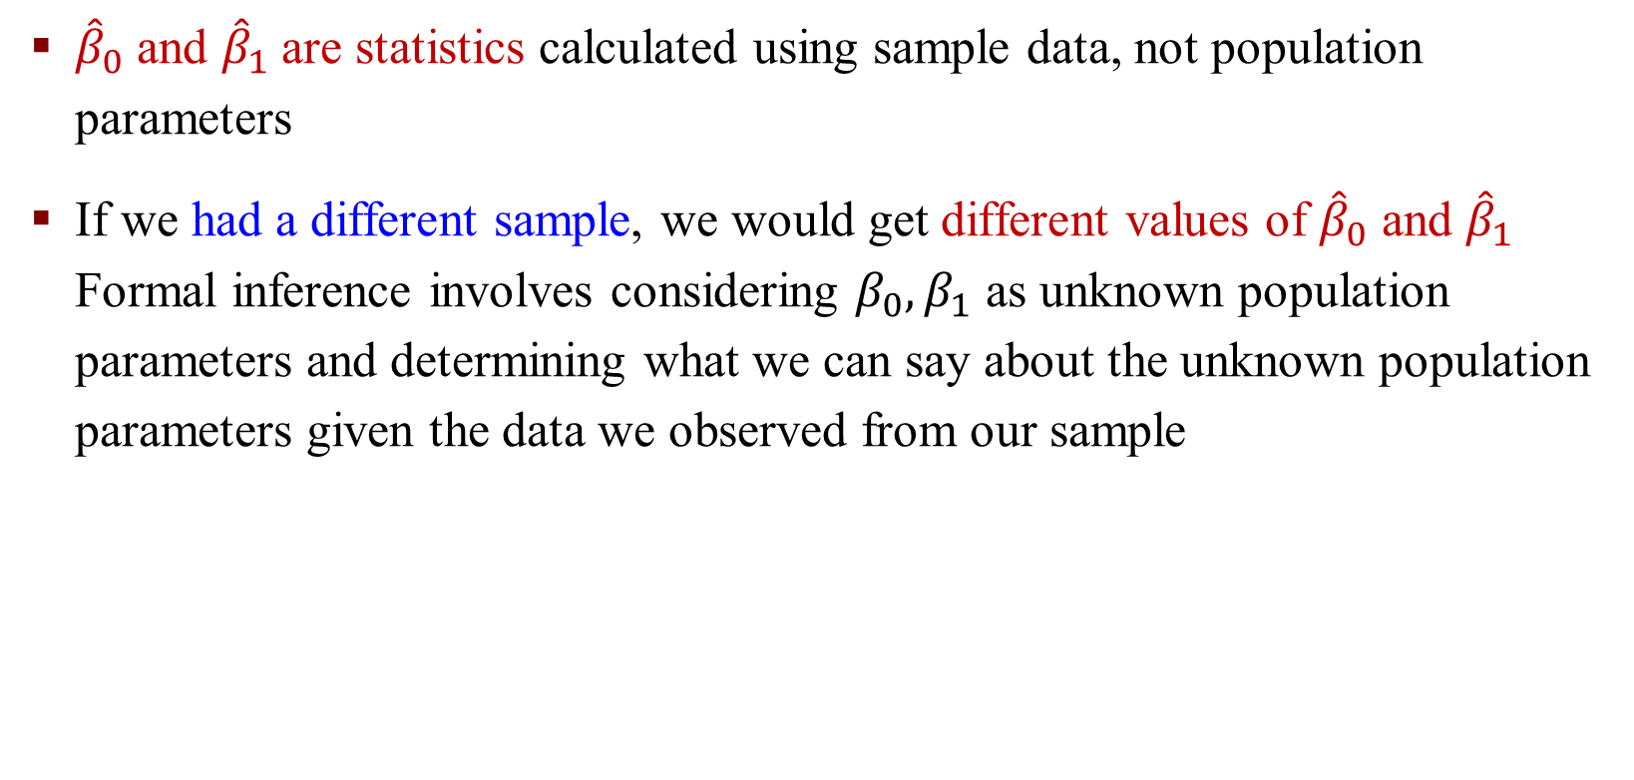
Inference about Regression Coefficients
${\hat{β}}_{0}$ and ${\hat{β}}_{1}$are statistics calculated using sample data, not population parameters
If we had a different sample, we would get different values of ${\hat{β}}_{0}$ and ${\hat{β}}_{1}$ Formal inference involves considering $β_{0},β_{1}$ as unknown population parameters and determining what we can say about the unknown population parameters given the data we observed from our sample

Slide 20
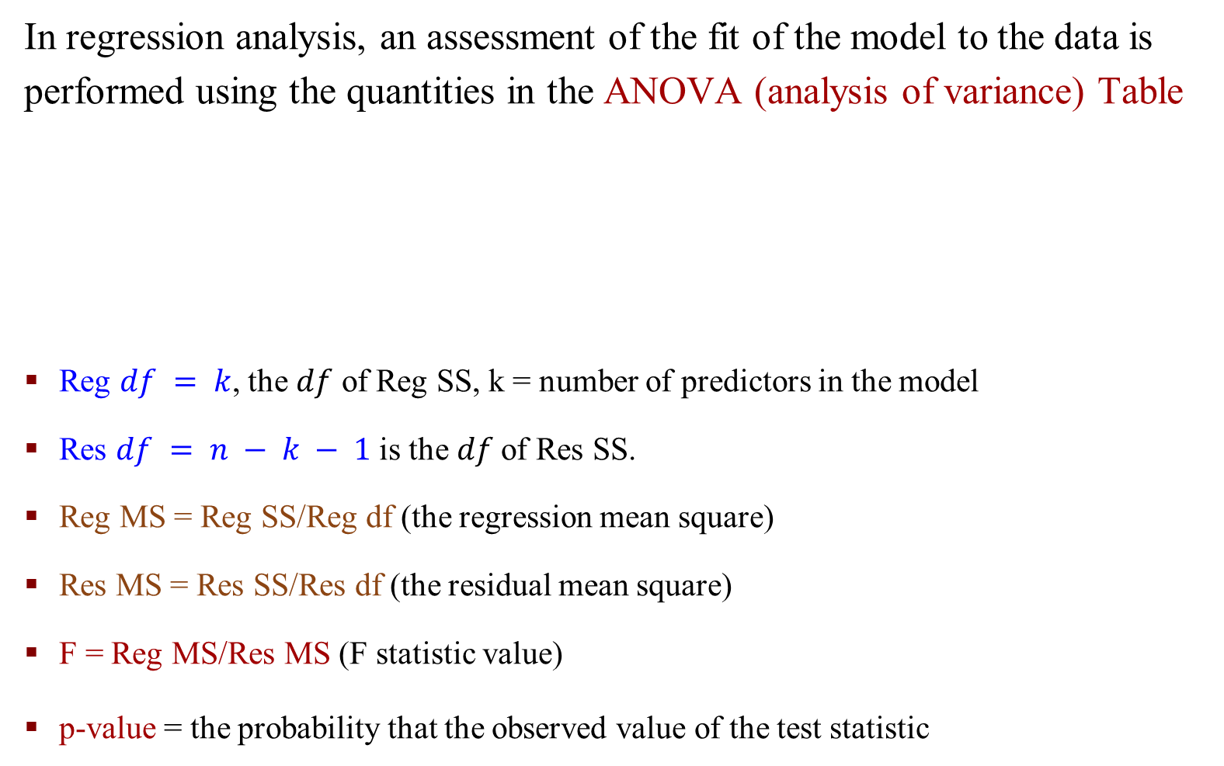
Inference about Regression Coefficients
In regression analysis, an assessment of the fit of the model to the data is performed using the quantities in the ANOVA (analysis of variance) Table
Reg $df = k$, the $df$ of Reg SS, k = number of predictors in the model
Res $df = n − k − 1$ is the $df$of Res SS.
Reg MS = Reg SS/Reg df (the regression mean square)
Res MS = Res SS/Res df (the residual mean square)
F = Reg MS/Res MS (F statistic value)
p-value = the probability that the observed value of the test statistic

Slide 21

An Example: Calculate R²
The association between husbands and wives ages was calculated to be
$\hat{y}$= −4.94 + 1.19$x$. Using this and the fact that $\overline{y}$ = 26, calculate by hand the quantities from the ANOVA table.
Calculate R-squared and give its interpretation.
Reg $df = 1$ for SLR, Res $df = n−k−1 = n−2 = 5−2 = 3$.
Notes:
df = k, k is the number of variable in the model. Here only has x

Slide 22
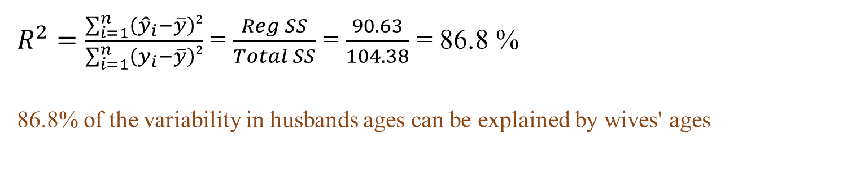
An Example: Calculate R²
$R^{2}=\frac{\sum_{i=1}^{n}{\left({\hat{y}}_{i}−\overline{y}\right)2}}{\sum_{i=1}^{n}{\left(y_{i}−\overline{y}\right)2}}$ = $\frac{Reg SS}{Total SS}$ = $\frac{90.63}{104.38}$ = 86.8 %
86.8% of the variability in husbands ages can be explained by wives' ages

Slide 23

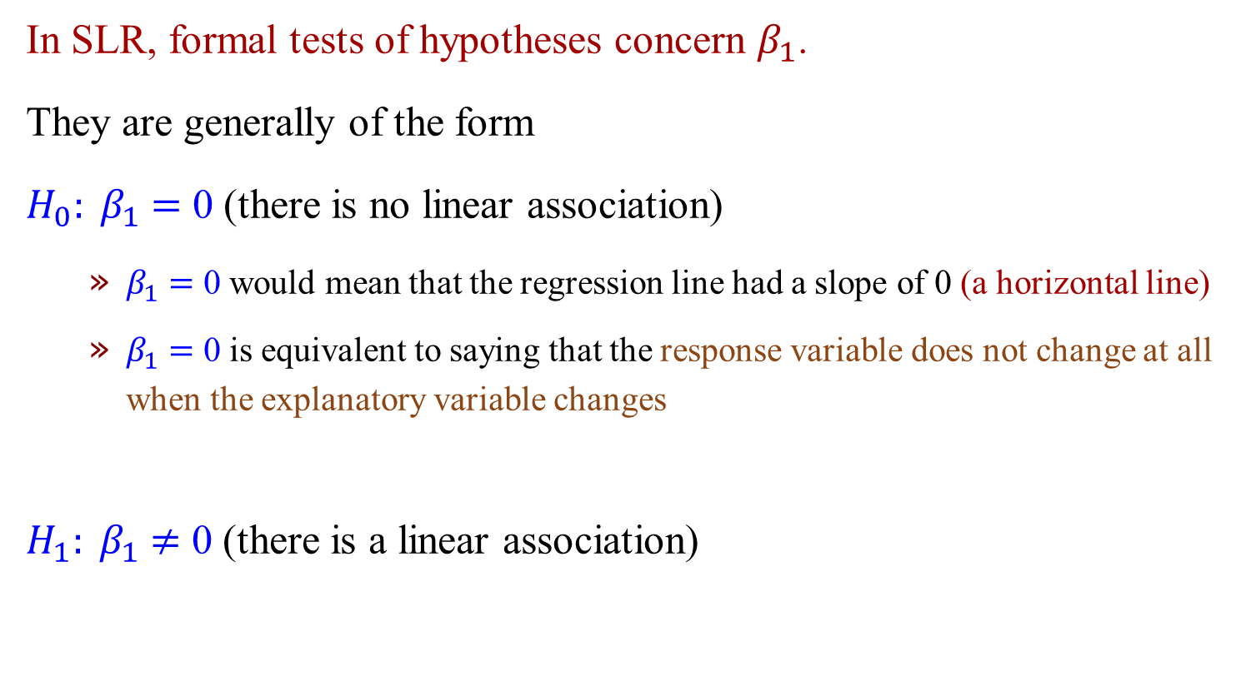
Formal Tests of Hypotheses
In SLR, formal tests of hypotheses concern $β_{1}$.
They are generally of the form
$H_{0}: β_{1}$ $=$ 0 (there is no linear association)
$β_{1}$ $=$ 0 would mean that the regression line had a slope of 0 (a horizontal line)
$β_{1}$ $=$ 0 is equivalent to saying that the response variable does not change at all when the explanatory variable changes
$H_{1}: β_{1}$ $≠$ 0 (there is a linear association)
$$y=β_{0}+β_{1}x$$

Slide 24

F-test for Simple Linear Regression
$H_{0}: β_{1}$ $=$ 0 (there is no linear association)
$H_{1}: β_{1}$ $≠$ 0 (there is a linear association)
$$F=\frac{Reg MS}{Res MS}$$
F-distribution with 1 and n − 2 degrees of freedom under $H_{0}$
Notes:
One predictor

Slide 25


F-distribution
The F-distribution is named after the famous statistician R. A. Fisher¹.
F is the ratio of two variances.
The F-distribution is most commonly used in the Analysis of Variance (ANOVA) and the F test (to determine if two variances are equal).
It has a minimum of 0, but no
maximum value (all values are positive)
The peak is not far from 0
When referencing the F-distribution the
numerator degrees of freedom are always
given first, and switching the degrees of
freedom changes the distribution ($F(10,12)$does not equal $F(12,10)$).
$$F=\frac{Reg MS}{Res MS}$$
Notes:
Z-distribution, t-distribution, F-distribution

Slide 26
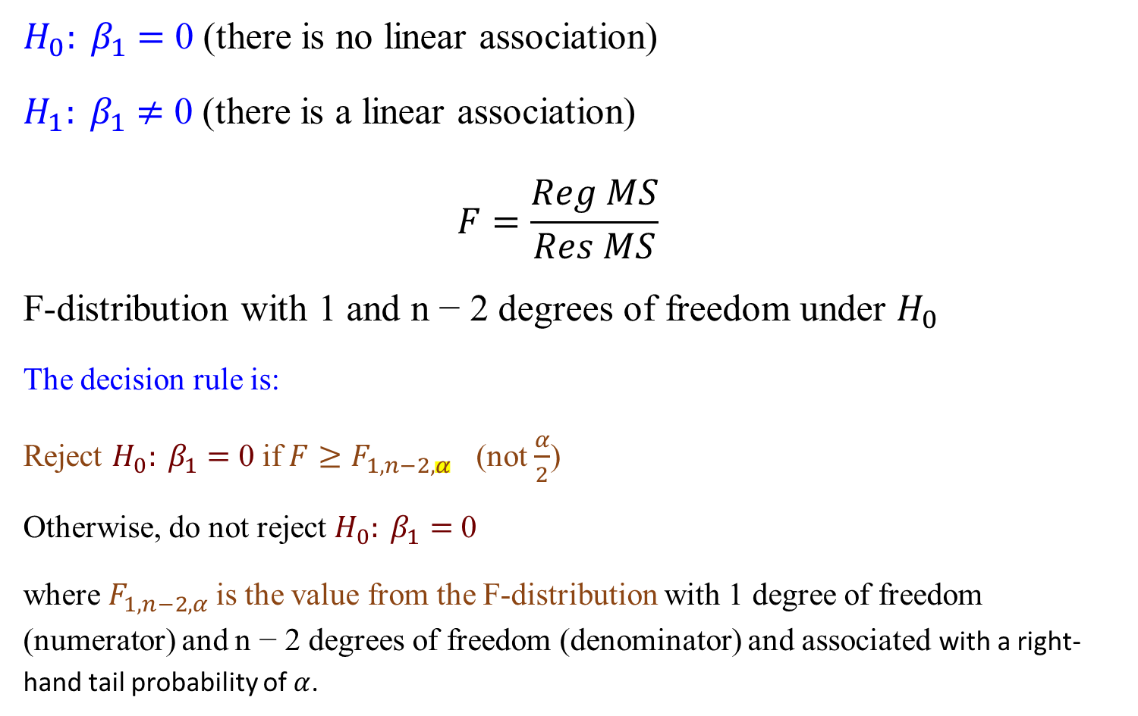
F-test for Simple Linear Regression
$H_{0}: β_{1}$ $=$ 0 (there is no linear association)
$H_{1}: β_{1}$ $≠$ 0 (there is a linear association)
$$F=\frac{Reg MS}{Res MS}$$
F-distribution with 1 and n − 2 degrees of freedom under $H_{0}$
The decision rule is:
Reject $H_{0}: β_{1}$ $=$ 0 if ${F≥F}_{1,n−2,α}$ (not $\frac{α}{2}$)
Otherwise, do not reject $H_{0}: β_{1}$ $=$ 0
where $F_{1,n−2,α}$is the value from the F-distribution with 1 degree of freedom (numerator) and n − 2 degrees of freedom (denominator) and associated with a right-hand tail probability of $α$.
Notes:
One-sided

Slide 27
R Functions – Quantities from the F-distribution

Slide 28
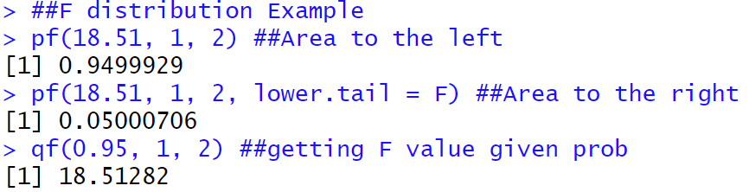
Quantities from the F-distribution

Slide 29
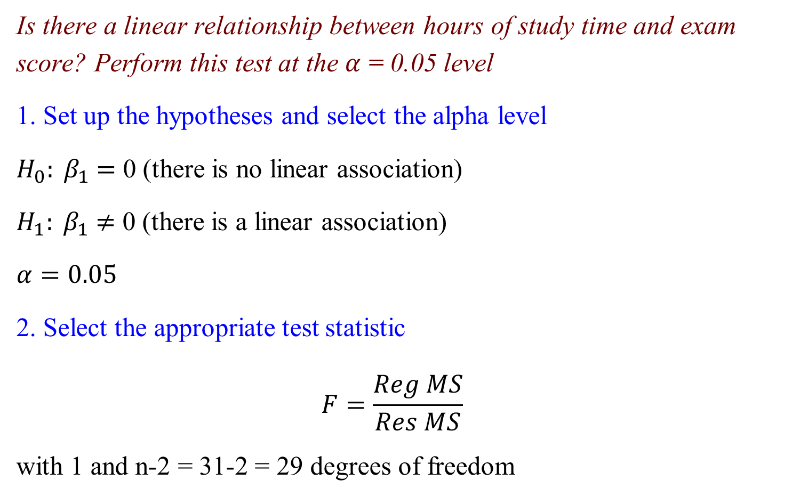
An Example: F-test for SLR
Is there a linear relationship between hours of study time and exam score? Perform this test at the $α$ = 0.05 level
1. Set up the hypotheses and select the alpha level
$H_{0}: β_{1}$ $=$ 0 (there is no linear association)
$H_{1}: β_{1}$ $≠$ 0 (there is a linear association)
$$α=0.05$$
2. Select the appropriate test statistic
$$F=\frac{Reg MS}{Res MS}$$
with 1 and n-2 = 31-2 = 29 degrees of freedom

Slide 30

An Example: F-test for SLR
3. State the decision rule
F-distribution with 1, 29 degrees of freedom and associated with $α$= 0.05
$F_{1,29,0.05}$= 4.1830
Decision Rule: Reject ${ H}_{0}$ if $F ≥$ 4.1830
Otherwise, do not reject${ H}_{0}$

Slide 31
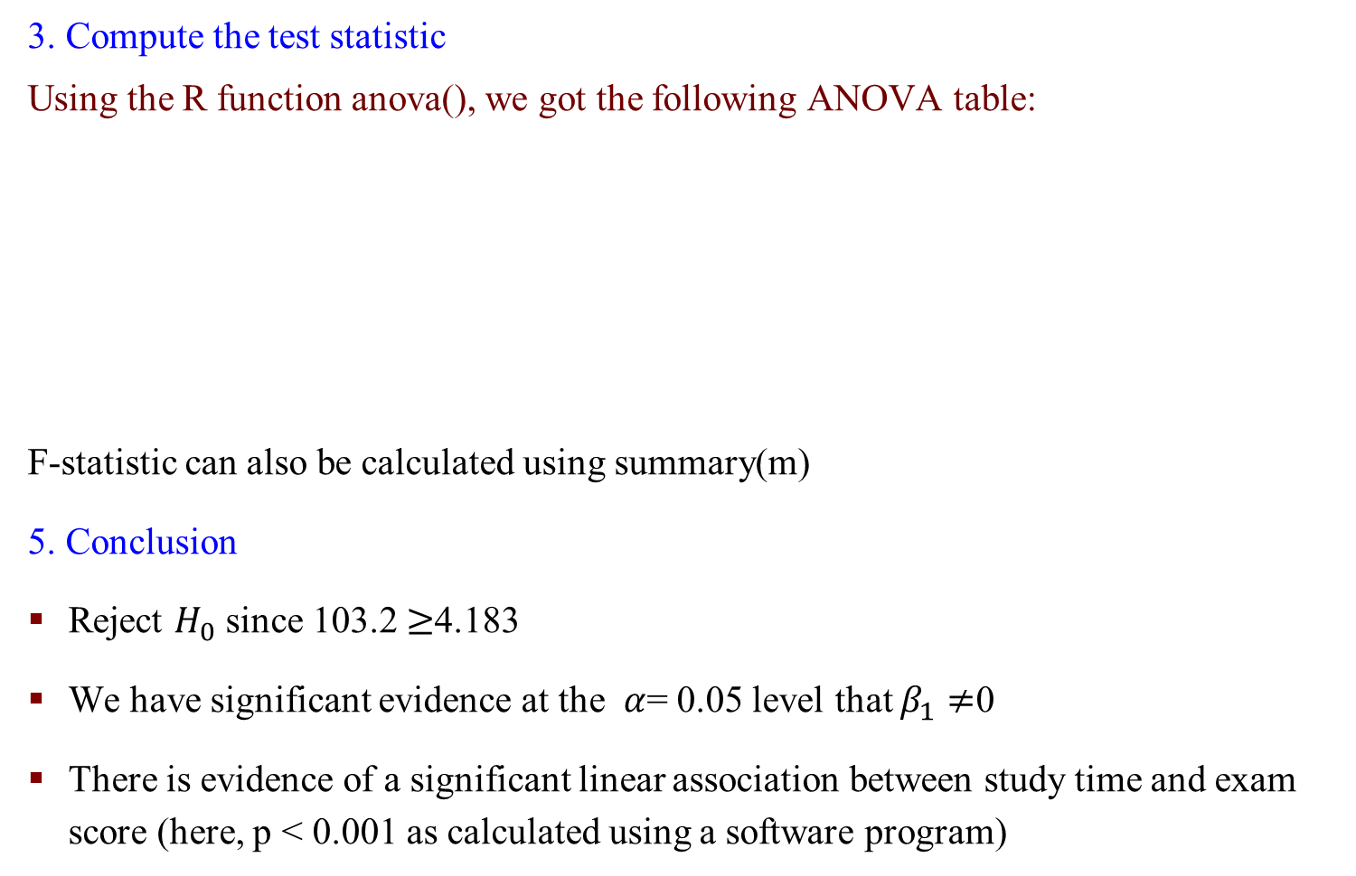
An Example: F-test for SLR
3. Compute the test statistic
Using the R function anova(), we got the following ANOVA table:
F-statistic can also be calculated using summary(m)
5. Conclusion
Reject $H_{0}$ since 103.2 $≥$4.183
We have significant evidence at the $α$= 0.05 level that $β_{1}≠$0
There is evidence of a significant linear association between study time and exam score (here, p < 0.001 as calculated using a software program)
m <- lm(score~study.hours)
anova(m)
Notes:
F score is big means Reg is bigger than Res

Slide 32
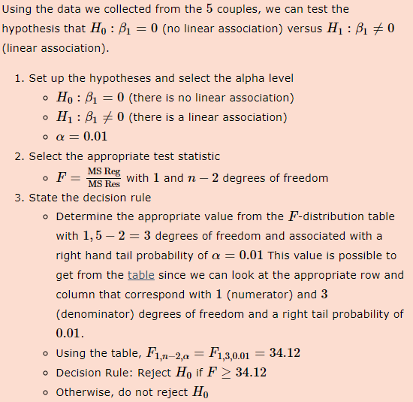
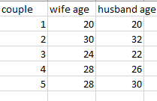
Exercise
Is there a linear relationship between the ages of husbands and wives? Perform this test at the α=0.01 level.

Slide 33
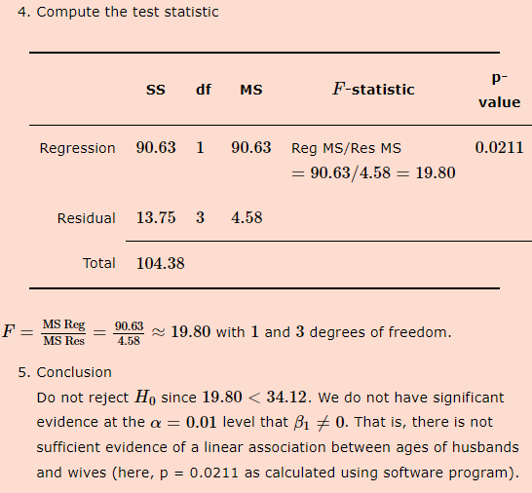

Slide 34
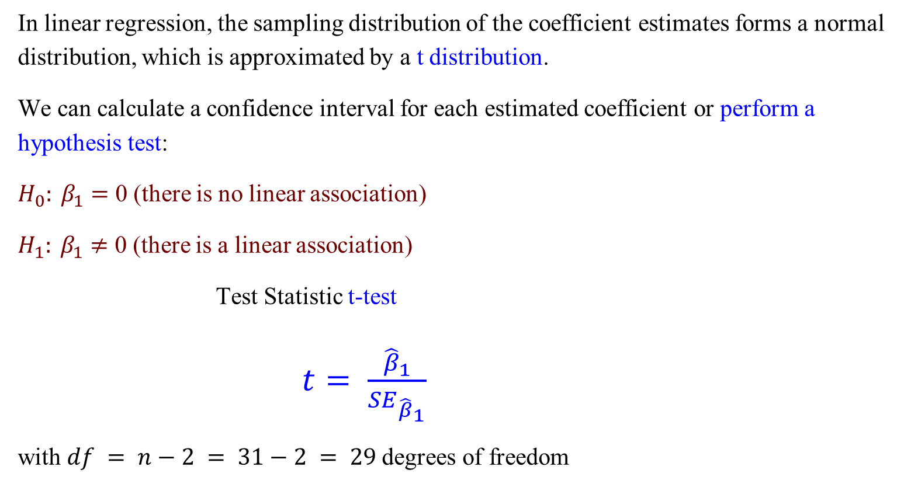
Inference from Regression – t-test
In linear regression, the sampling distribution of the coefficient estimates forms a normal distribution, which is approximated by a t distribution.
We can calculate a confidence interval for each estimated coefficient or perform a hypothesis test:
$H_{0}: β_{1}$ $=$ 0 (there is no linear association)
$H_{1}: β_{1}$ $≠$ 0 (there is a linear association)
Test Statistic t-test
$t= \frac{{\hat{β}}_{1}}{{SE}_{{\hat{β}}_{1}}}$
with $df = n−2 = 31−2 = 29$degrees of freedom

Slide 35

Normality Assumption - Standard Error of Regression Coefficients
How is the standard error of the estimator $\hat{β}$ calculated?
No worries! We use R to compute this.

Slide 36
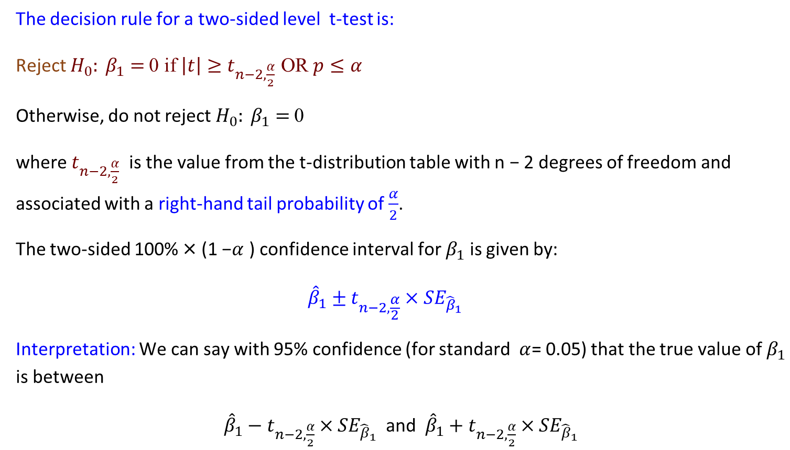
T-test for SLR – Confidence Interval
The decision rule for a two-sided level t-test is:
Reject $H_{0}: β_{1}$ $=$ 0 if $\left|t\right|≥t_{n−2,\frac{α}{2}}$ OR $p≤α$
Otherwise, do not reject $H_{0}: β_{1}$ $=$ 0
where $t_{n−2,\frac{α}{2}}$ is the value from the t-distribution table with n − 2 degrees of freedom and associated with a right-hand tail probability of $\frac{α}{2}$.
The two-sided 100% × (1 −$α$ ) confidence interval for $β_{1}$ is given by:
$${{\hat{β}}_{1}±t}_{n−2,\frac{α}{2}}×{SE}_{{\hat{β}}_{1}}$$
Interpretation: We can say with 95% confidence (for standard $α$= 0.05) that the true value of $β_{1}$ is between
${{\hat{β}}_{1}−t}_{n−2,\frac{α}{2}}×{SE}_{{\hat{β}}_{1}}$ and ${{\hat{β}}_{1}+t}_{n−2,\frac{α}{2}}×{SE}_{{\hat{β}}_{1}}$

Slide 37
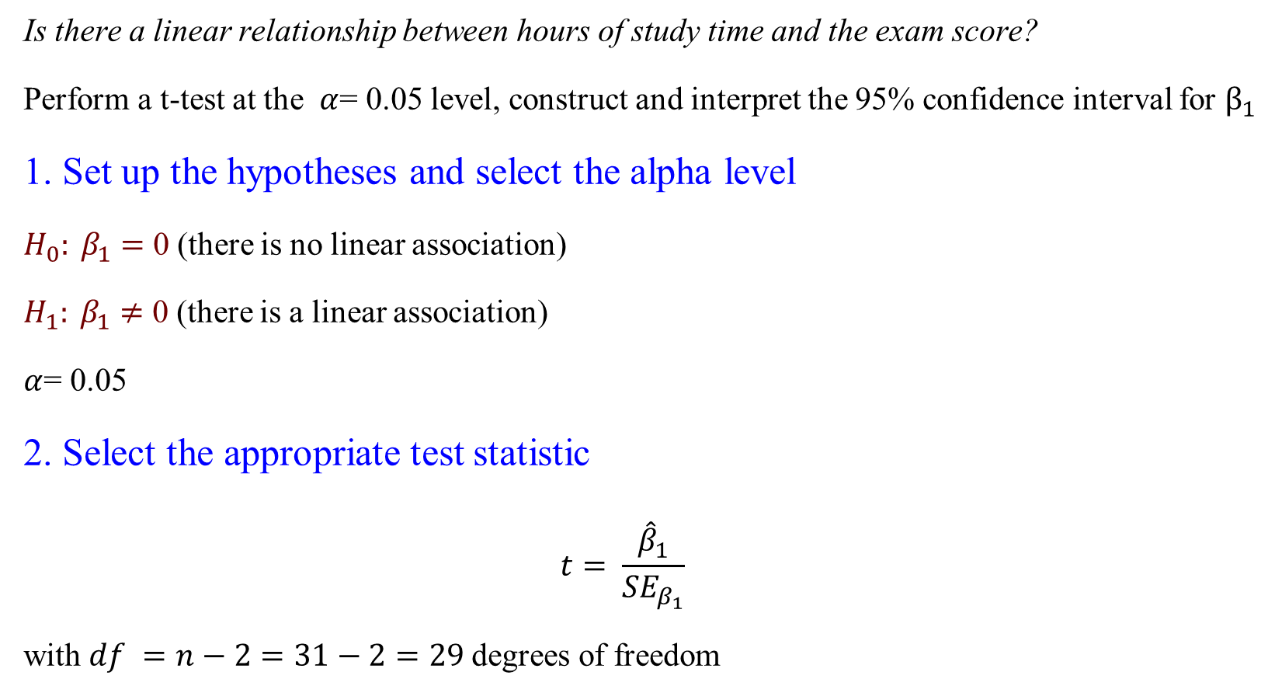
An Example – t-test for SLR
Is there a linear relationship between hours of study time and the exam score?
Perform a t-test at the $α$= 0.05 level, construct and interpret the 95% confidence interval for $β_{1}$
1. Set up the hypotheses and select the alpha level
$H_{0}: β_{1}$ $=$ 0 (there is no linear association)
$H_{1}: β_{1}$ $≠$ 0 (there is a linear association)
$α$= 0.05
2. Select the appropriate test statistic
$$t= \frac{{\hat{β}}_{1}}{{SE}_{β_{1}}}$$
with $df =n−2=31−2=29$degrees of freedom

Slide 38
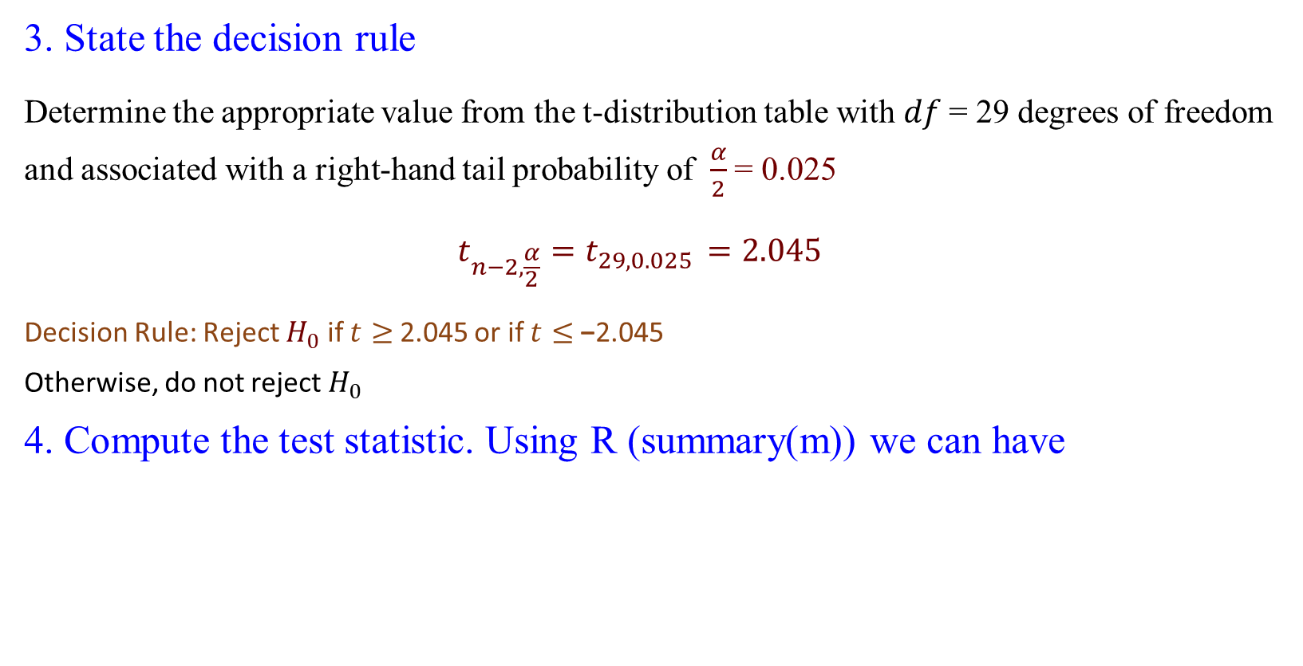


An Example – t-test for SLR
3. State the decision rule
Determine the appropriate value from the t-distribution table with $df$= 29 degrees of freedom and associated with a right-hand tail probability of $\frac{α}{2}$= 0.025
$$t_{n−2,\frac{α}{2}}=t_{29,0.025 }=2.045$$
Decision Rule: Reject $H_{0}$ if $t≥$ 2.045 or if $t≤$−2.045
Otherwise, do not reject $H_{0}$
4. Compute the test statistic. Using R (summary(m)) we can have
$${\hat{β}}_{0}$$
$${\hat{β}}_{1}$$
Notes:
qt(0.975, df=29)=2.045
summary(m) gives the table

Slide 39
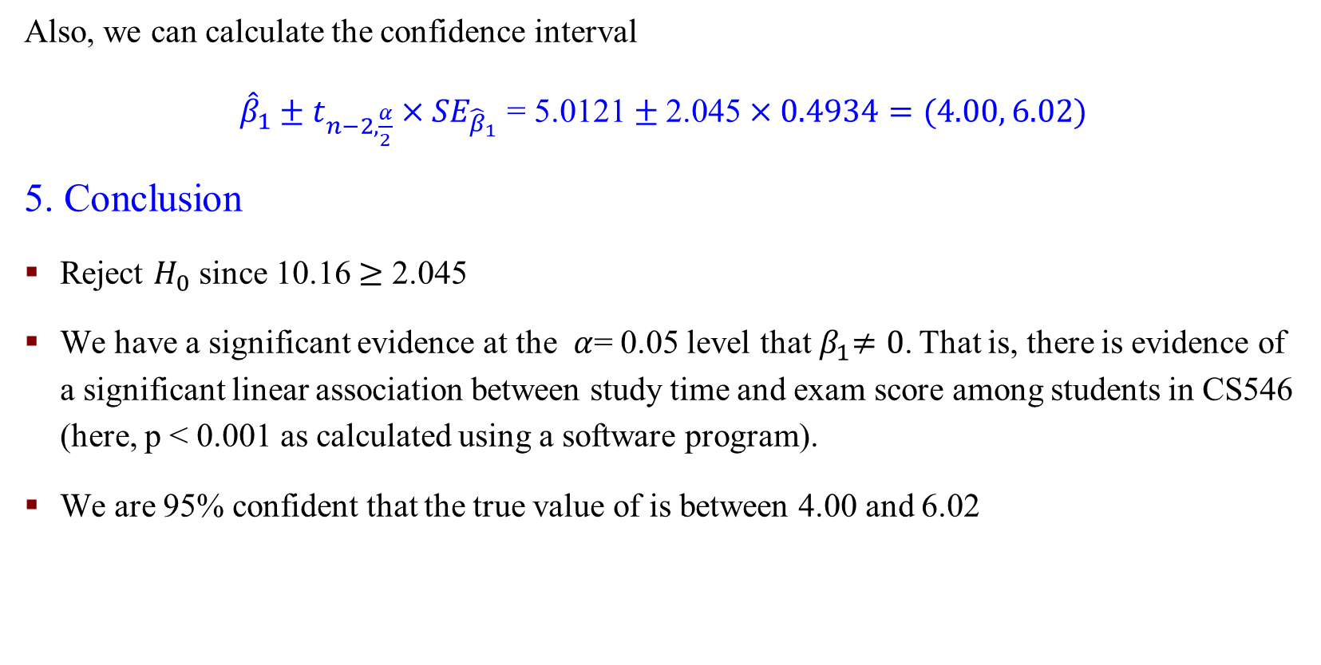
An Example – t-test for SLR
Also, we can calculate the confidence interval
${{\hat{β}}_{1}±t}_{n−2,\frac{α}{2}}×{SE}_{{\hat{β}}_{1}}$ = 5.0121$±$ 2.045$×0.4934=(4.00, 6.02)$
5. Conclusion
Reject $H_{0}$ since 10.16 $≥$ 2.045
We have a significant evidence at the $α$= 0.05 level that${ β}_{1}≠0$. That is, there is evidence of a significant linear association between study time and exam score among students in CS546 (here, p < 0.001 as calculated using a software program).
We are 95% confident that the true value of is between 4.00 and 6.02

Slide 40
R Functions – lm(), anova(), fitted(), resid()

Slide 41
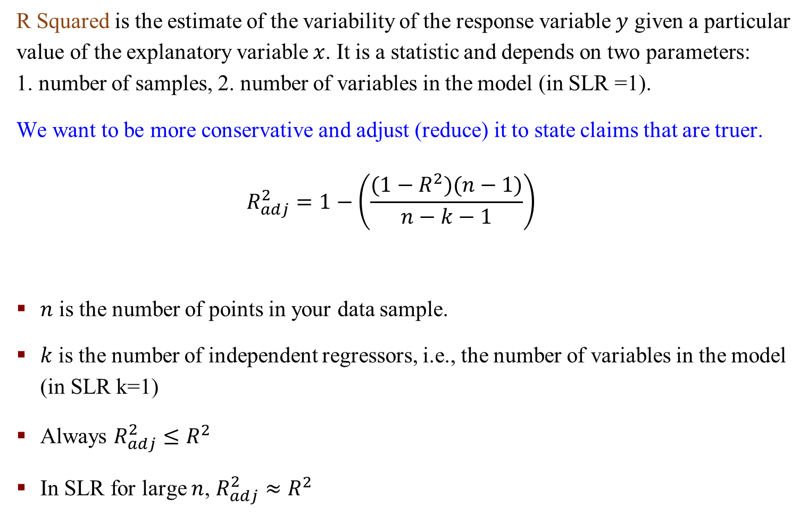
Adjusted R²
R Squared is the estimate of the variability of the response variable $y$ given a particular value of the explanatory variable $x$. It is a statistic and depends on two parameters:
1. number of samples, 2. number of variables in the model (in SLR =1).
We want to be more conservative and adjust (reduce) it to state claims that are truer.
$$R_{adj}^{2}=1−\left(\frac{(1−R^{2})(n−1)}{n−k−1}\right)$$
$n$ is the number of points in your data sample.
$k$ is the number of independent regressors, i.e., the number of variables in the model (in SLR k=1)
Always $R_{adj}^{2}≤R^{2}$
In SLR for large $n$, $R_{adj}^{2}≈R^{2}$

Slide 42
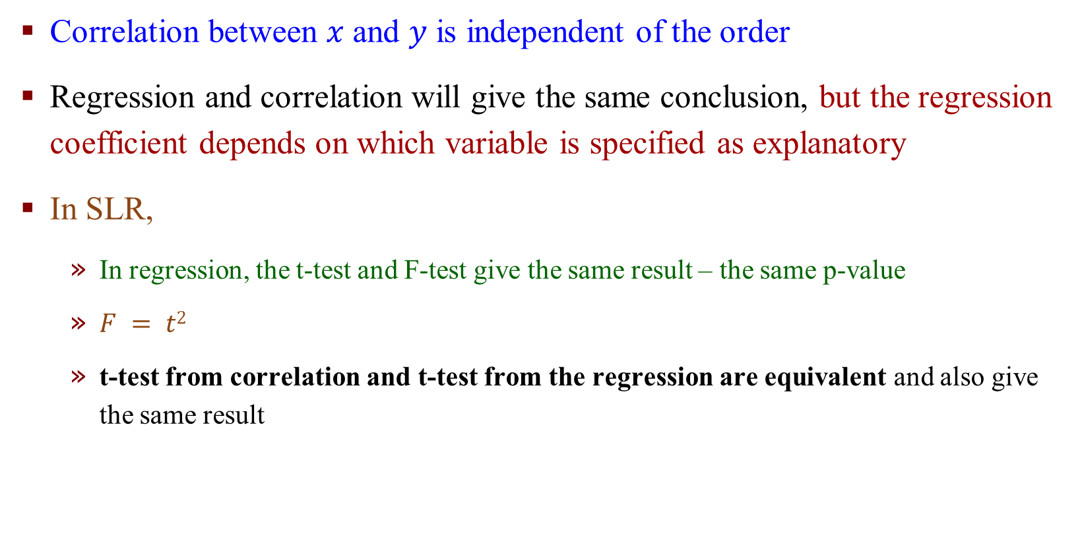
Closing Remarks – Some Key Points
Correlation between $x$ and $y$ is independent of the order
Regression and correlation will give the same conclusion, but the regression coefficient depends on which variable is specified as explanatory
In SLR,
In regression, the t-test and F-test give the same result – the same p-value
$F = t2$
t-test from correlation and t-test from the regression are equivalent and also give the same result

